Slide 1

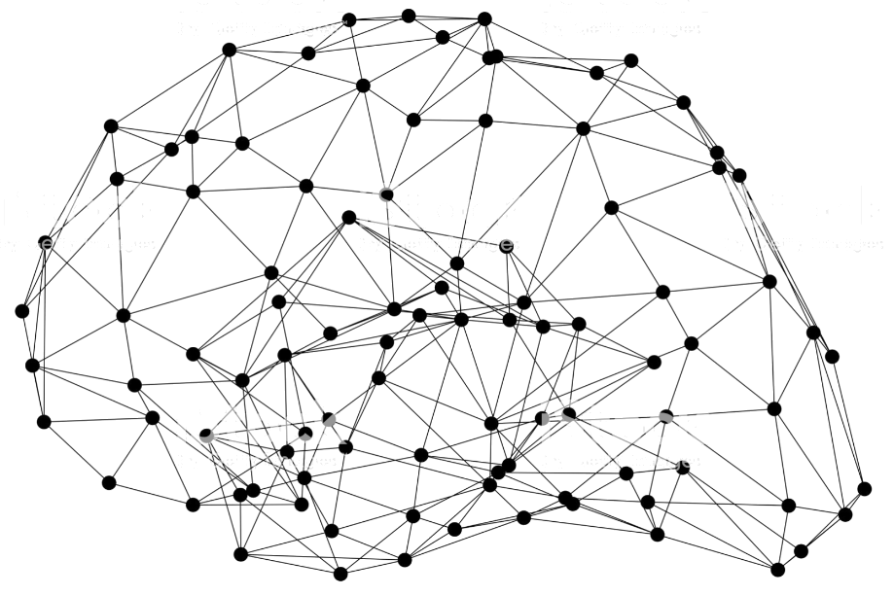
GluonCV: Segmentation
Notes:
First call deck for a high level introduction to Apache MXNet.

Slide 2
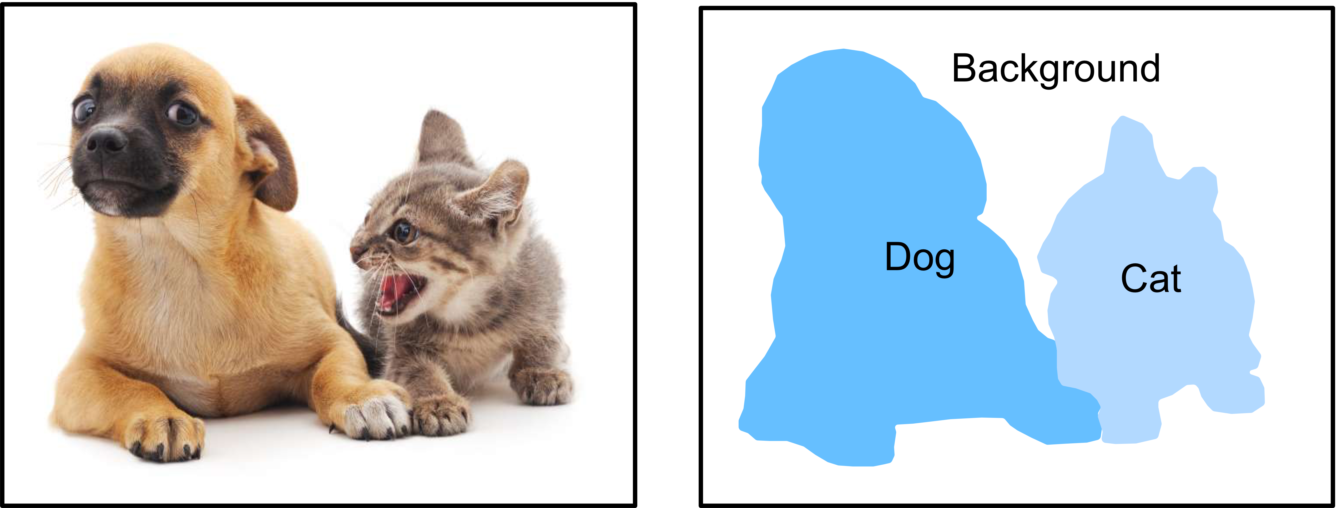
What’s segmentation
Classify and mask the pixels of the object
Notes:
Let’s now take a look at segmentation tasks. The goal of segmentation is to classify and mask the pixels of the object or objects.

Slide 3
Implement SOTA Segmentation Models with GluonCV
Method | Metric | GluonCV | Reference
DeepLab-v3 | mIoU on VOC | 86.7% | 85.7%(paper)
Mask-RCNN-ResNet50 | Mask AP on COCO | 33.1% | 32.8%(Detectron)
Mask-RCNN-Resnet101-FPN | Mask AP on COCO | 37.7% | 36.4%(Detectron)
SOTA pre-trained models

Slide 4
Implement SOTA Segmentation Models with GluonCV
Data API
Automated data preparation
Dataset specialized for Segmentation
Transformation API
Metric API
Loss API
Pre-defined network architectures
Building-blocks
Custom Layers
Reproducible Experiments
Training Script
Configurations
Available in GluonCV

Slide 5
Implement SOTA Segmentation Models with GluonCV
Images and Ground Truths

Slide 6
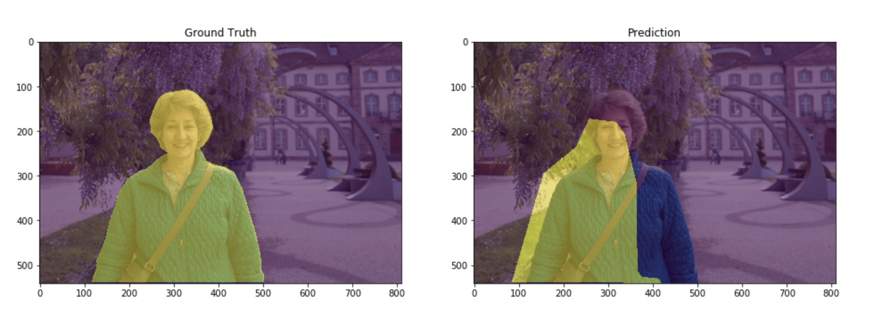
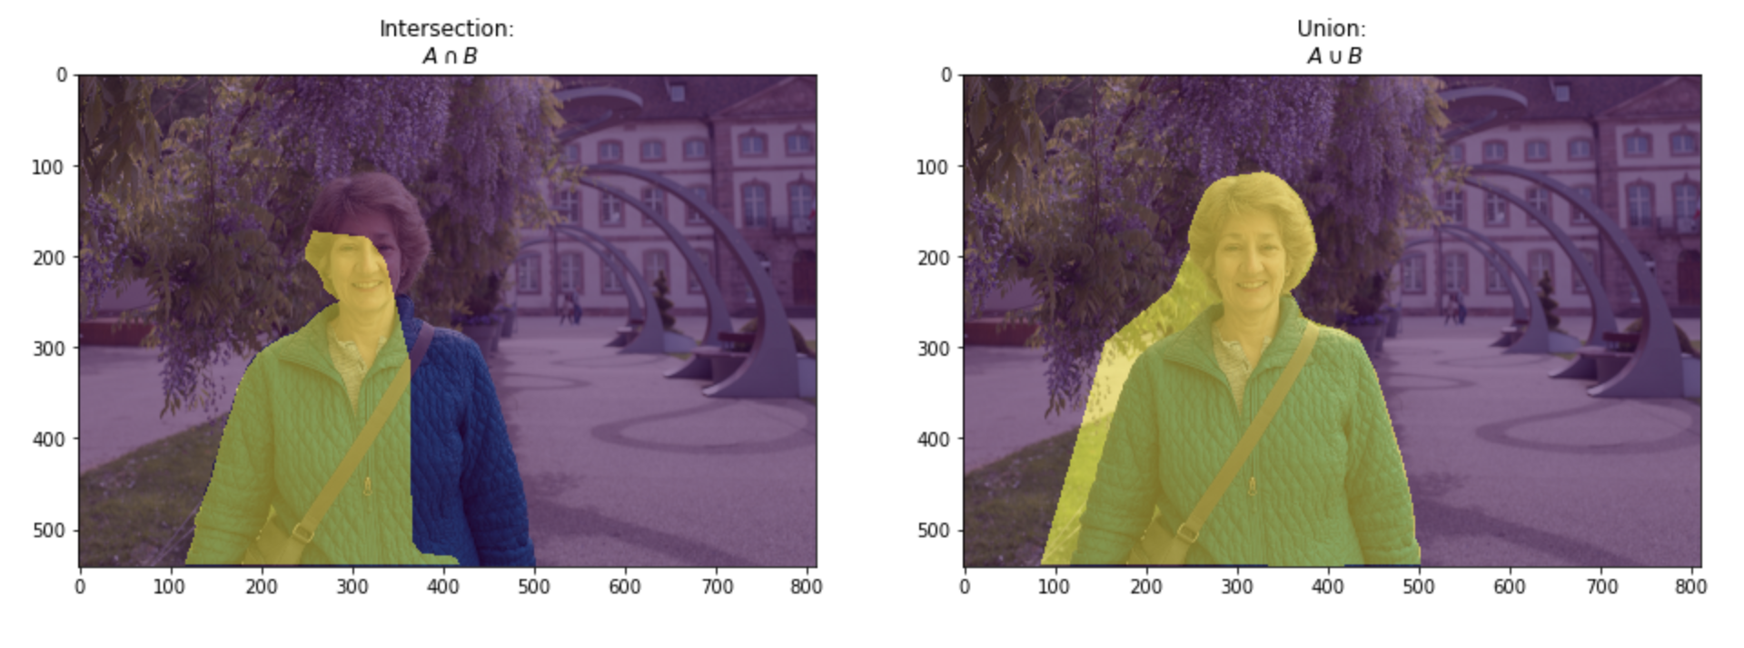
Implement SOTA Segmentation Models with GluonCV
Metrics
PixAcc
mIoU

Slide 7
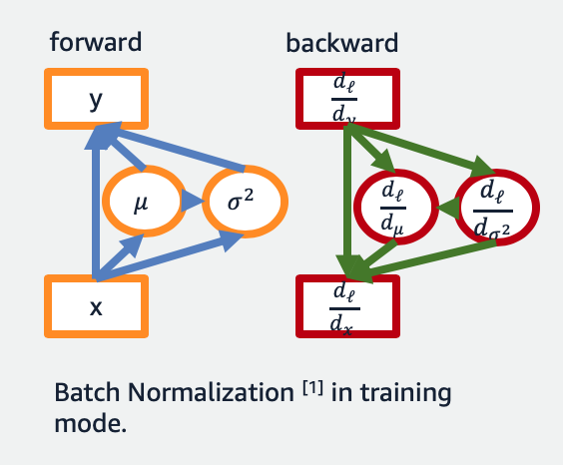
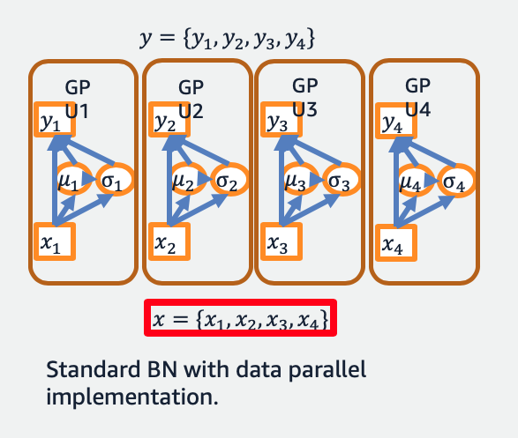
Implement SOTA Segmentation Models with GluonCV
Standard BN and Data Parallelism
¹Ioffe and Szegedy. "Batch normalization: Accelerating deep network training by reducing internal covariate shift.” ICML. 2015.
Notes:
Sync-BN is critical for Semantic Segmentation tasks due to the nature that the memory consumption is higher and therefore effective batch-size on each GPU is smaller.

Slide 8
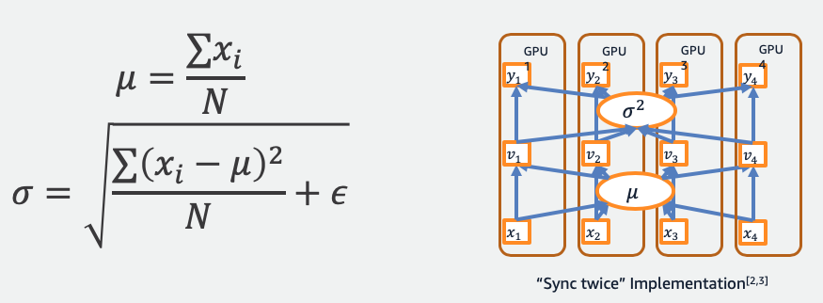
Implement SOTA Segmentation Models with GluonCV
Synchronized BatchNorm(”Sync twice”)
²Peng, Chao, et al. "MegDet: A Large Mini-Batch Object Detector.” CVPR2018
³Liu, Shu, et al. "Path Aggregation Network for Instance Segmentation.” CVPR2018
Notes:
Instead of doing typical sync twice implementation illustrated on this figure

Slide 9
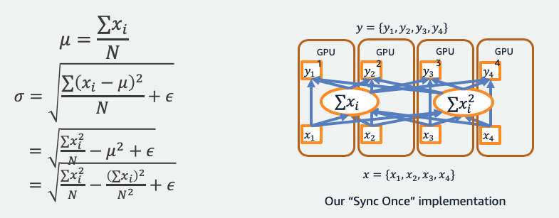
Implement SOTA Segmentation Models with GluonCV
Synchronized BatchNorm(”Sync once”)
⁴Zhang, Hang, et al. "Context encoding for semantic segmentation." The IEEE Conference on Computer Vision and Pattern Recognition (CVPR). 2018.
Notes:
GluonCV use sync once approach to reduce communication overhead, and therefore the training is faster.

Slide 10
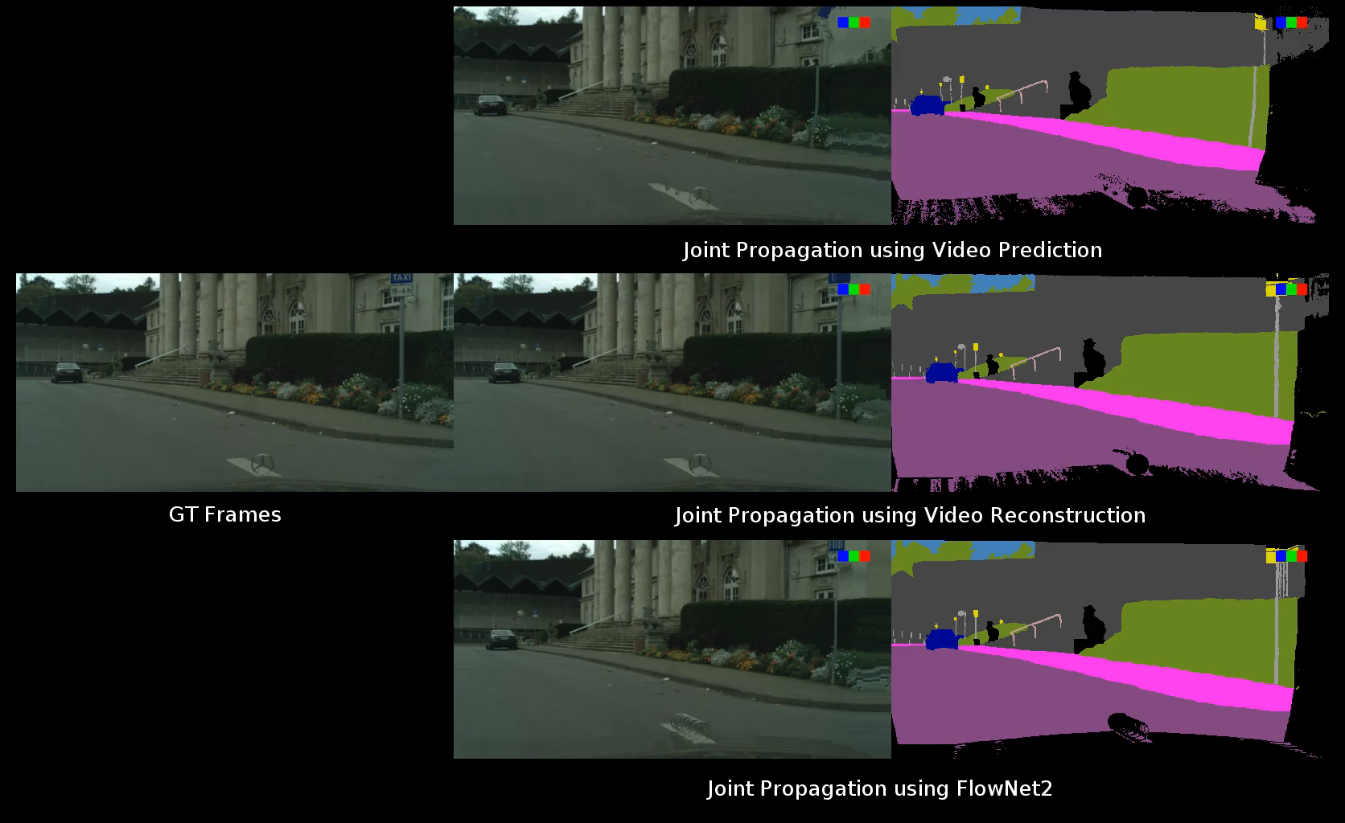

Implement SOTA Segmentation Models with GluonCV
Cityscapes Synthesized Training Samples
Joint Propagation using video prediction
Propagation [t-5, t+5]
GT frames
Joint Propagation using VPLR Approach
synthesized samples
Joint Propagation using Flownet2
⁵Zhu, et al. "Improving Semantic Segmentation via Video Propagation and Label Relaxation." The IEEE Conference on Computer Vision and Pattern Recognition (CVPR). 2019.
Notes:
GluonCV also includes the latest video propagation techniques.

Slide 11

Implement SOTA Segmentation Models with GluonCV
More robust visualization results
⁵Zhu, et al. "Improving Semantic Segmentation via Video Propagation and Label Relaxation." The IEEE Conference on Computer Vision and Pattern Recognition (CVPR). 2019.

Slide 12
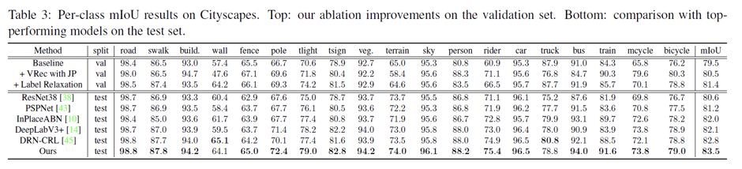
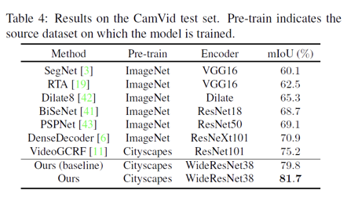
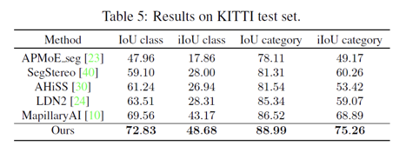
Implement SOTA Segmentation Models with GluonCV
⁵Zhu, et al. "Improving Semantic Segmentation via Video Propagation and Label Relaxation." The IEEE Conference on Computer Vision and Pattern Recognition (CVPR). 2019.

Slide 13
Hands On!

Slide 14

Like GluonCV? Go build!
https://github.com/dmlc/gluon-cv
https://gluon-cv.mxnet.io

